Slide 1

machine learning an introduction
Seth Juarez
seth.juarez@microsoft.com
@sethjuarez

Slide 2
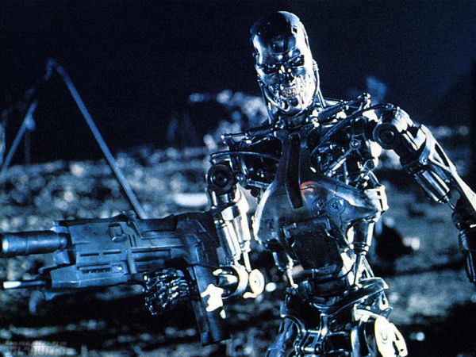
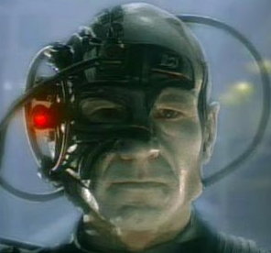


Slide 3
agenda
data science
prediction
process
models
nuML

Slide 4
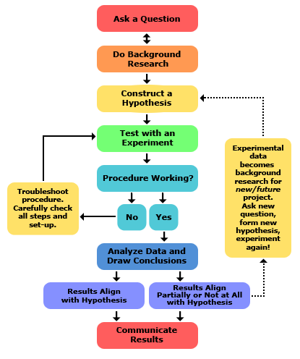
data science
key word: science
try stuff
it (might not | won’t) work the first time

Slide 5
machine learning
finding (and exploiting) patterns in data
replacing “human writing code” with “human supplying data”
system figures out what the person wants based on examples
need to abstract from “training” examples to “test” examples
most central issue in ML: generalization
Notes:
bfs – complete, optimal if non-decreasing function in depth of the node (if the shallowest node is not the optimal one, all bets are off)
ucs – same as above
dfs – complete (maybe…), not optimal if it starts down a suboptimal path,
dls – complete if correct depth (or correct assessment of problem diameter), optimal - maybe

Slide 6
machine learning
split into two (ish) areas
supervised learning
predicting the future
learn from past examples to predict future
unsupervised learning
understanding the past
making sense of data
learning structure of data
compressing data for consumption
Notes:
bfs – complete, optimal if non-decreasing function in depth of the node (if the shallowest node is not the optimal one, all bets are off)
ucs – same as above
dfs – complete (maybe…), not optimal if it starts down a suboptimal path,
dls – complete if correct depth (or correct assessment of problem diameter), optimal - maybe

Slide 7
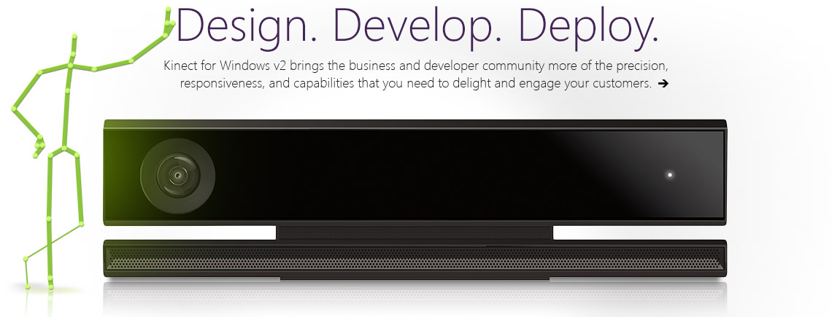
neat applications

Slide 8
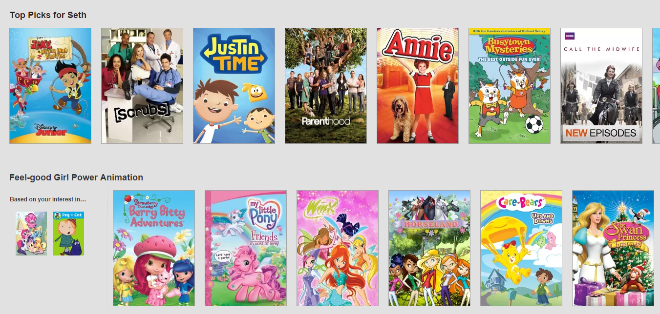
neat applications

Slide 9
neat applications
spam catchers
ocr (optical character recognition)
natural language processing
machine translation
biology
medicine
robotics (autonomous systems)
etc…

Slide 10
prediction
making decisions

Slide 11
making decisions
what kinds of decisions are we making?
binary classification
yes/no, 1/0, male/female
multi-class classification
{A, B, C, D, F} (Grade), {1, 2, 3, 4} (Class), {teacher, student, secretary}
regression
number between 0 and 100, real value

Slide 12
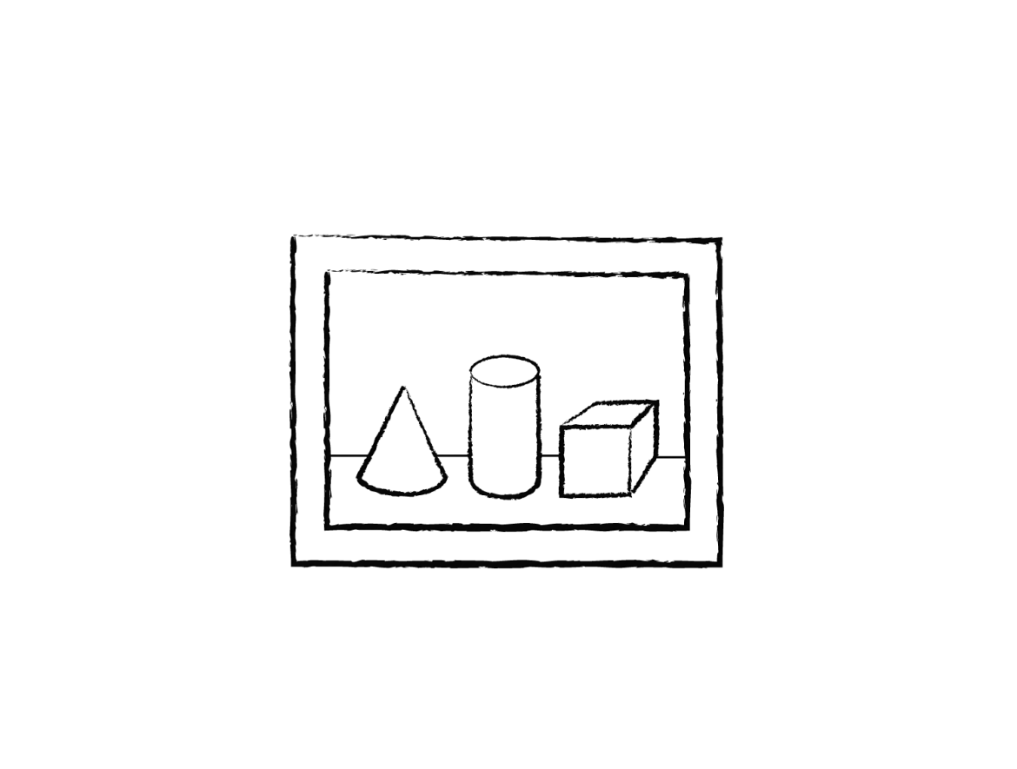
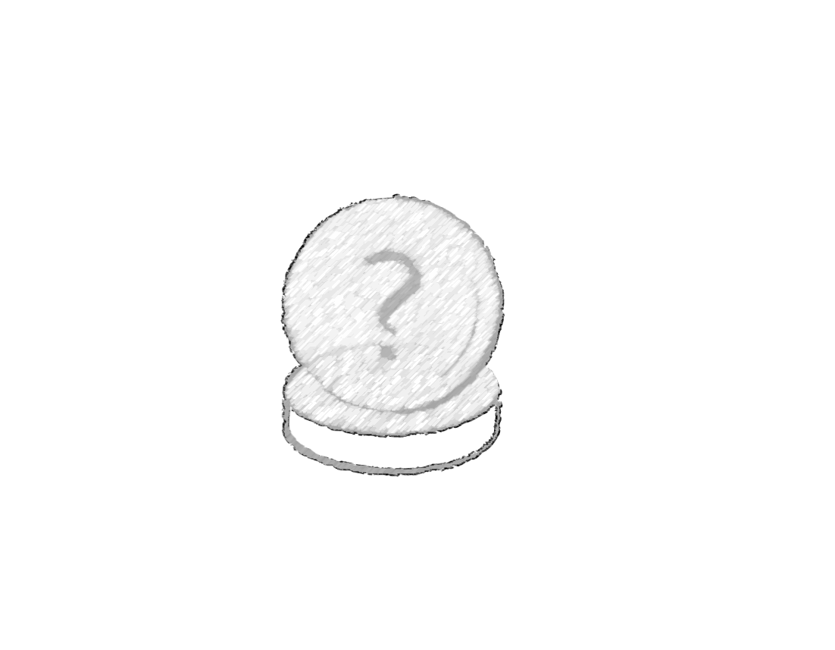
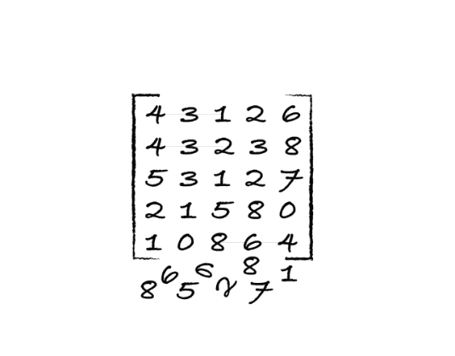
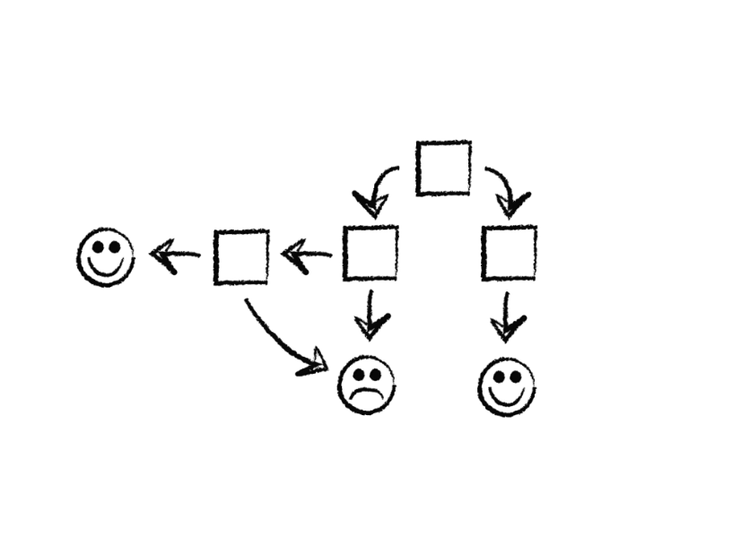
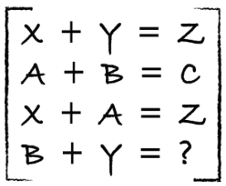
process
data
predict
1
4
clean
transform
maths
model
2
3

Slide 13
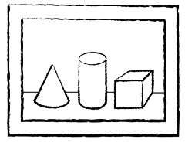
data
Class | Outlook | Temp. | Windy
Play | Sunny | Low | Yes
No Play | Sunny | High | Yes
No Play | Sunny | High | No
Play | Overcast | Low | Yes
Play | Overcast | High | No
Play | Overcast | Low | No
No Play | Rainy | Low | Yes
Play | Rainy | Low | No
? | Sunny | Low | No
label (y)
play / no play
features
outlook, temp, windy
values (x)
[Sunny, Low, Yes]
Labeled dataset is a collection of (X, Y) pairs.
Given a new x, how do we predict y?

Slide 14
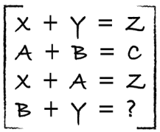
clean / transform / maths
Class | Outlook | Temp. | Windy
Play | Sunny | Lowest | Yes
No Play | ? | High | Yes
No Play | Sunny | High | KindOf
Play | Overcast | Low | Yes
Play | Turtle Cloud | High | No
Play | Overcast | ? | No
No Play | Rainy | Low | 28%
Play | Rainy | Low | No
? | Sunny | Low | No
yak shaving
Any apparently useless activity which, by allowing you to overcome intermediate difficulties, allows you to solve a larger problem.
I was doing a bit of yak shaving this morning, and it looks like it might have paid off.
wikipedia
need to clean up data
need to convert to model-able form (linear algebra)

Slide 15
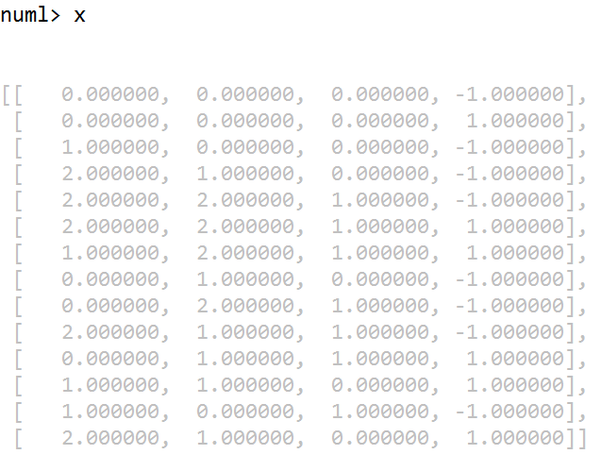
clean / transform / maths
Class | Outlook | Temp. | Windy
Play | Sunny | Low | Yes
No Play | Sunny | High | Yes
No Play | Sunny | High | No
Play | Overcast | Low | Yes
Play | Overcast | High | No
Play | Overcast | Low | No
No Play | Rainy | Low | Yes
Play | Rainy | Low | No
? | Sunny | Low | No

Slide 16
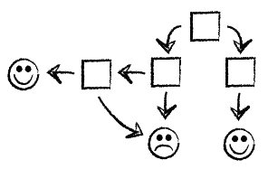
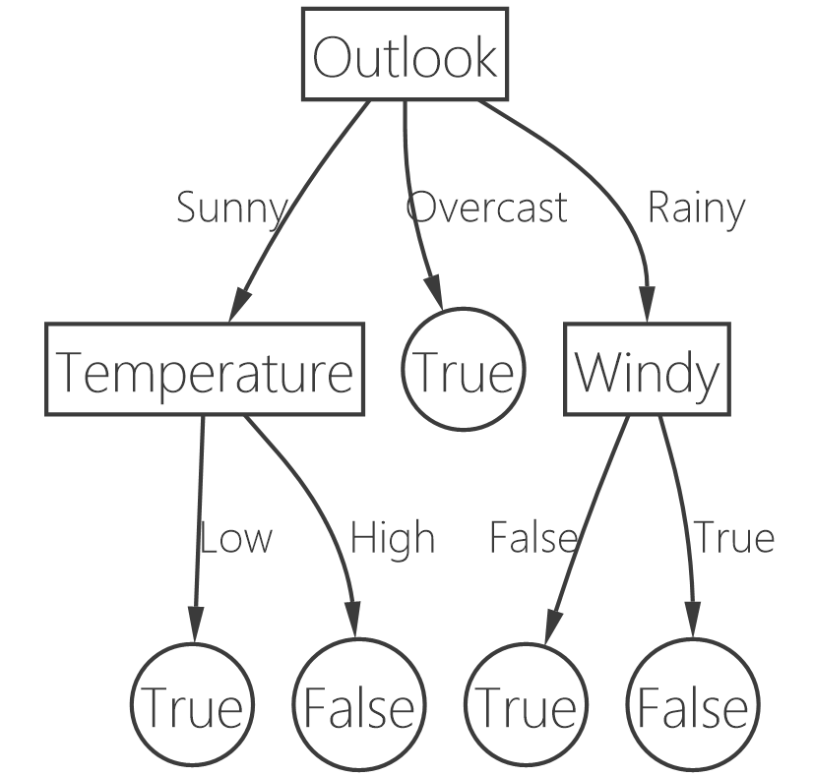
model
Class | Outlook | Temp. | Windy
Play | Sunny | Low | Yes
No Play | Sunny | High | Yes
No Play | Sunny | High | No
Play | Overcast | Low | Yes
Play | Overcast | High | No
Play | Overcast | Low | No
No Play | Rainy | Low | Yes
Play | Rainy | Low | No
? | Sunny | Low | No

Slide 17
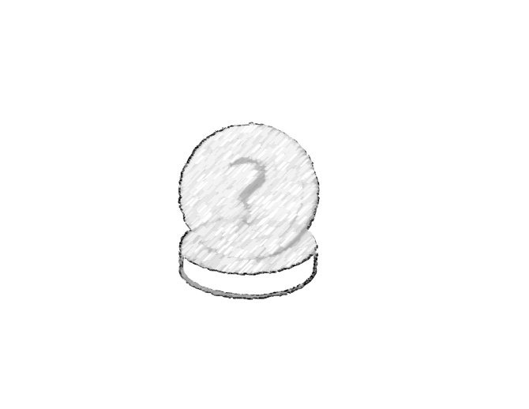

predict
Class | Outlook | Temp. | Windy
? | Sunny | Low | No
PLAY!!!

Slide 18
models
how do we build them?

Slide 19
linear classifiers
in order to classify things properly we need:
a way to mathematically represent examples
a way to separate classes (yes/no)
“decision boundary”
excel example
graph example

Slide 20
linear classifiers
dot product of vectors
[ 3, 4 ] ● [ 1, 2 ] = (3 × 1) + (4 × 2) = 11
a ● b = | a | × | b | cos θ
when does this equal 0?
why would this be useful?
decision boundary can be represented using a single vector

Slide 21
perceptron
… and other linear models

Slide 22
perceptron
Frank Rosenblatt, Cornell 1957
let’s make a line (by using a single vector)
take the dot product between the line and the new point
> 0 belongs to class 1
< 0 belongs to class 2
== 0 flip a coin we don’t know
for each example, if we make a mistake, move the line

Slide 23
perceptron
point demo

Slide 24
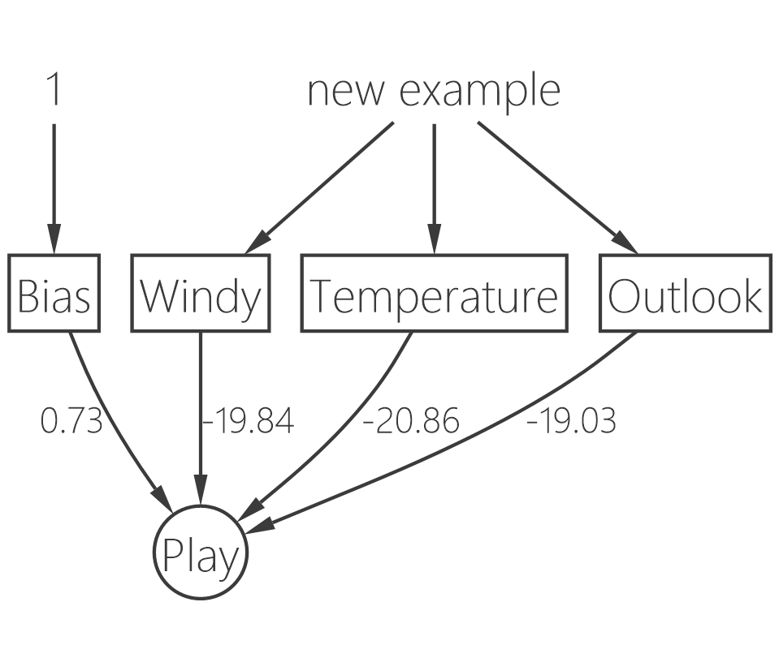
perceptron
numerical features
× (dot)
learned vector
+1 / -1

Slide 25
what if…

Slide 26
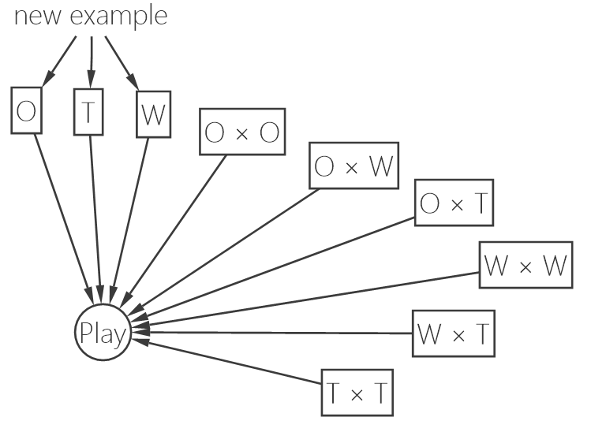
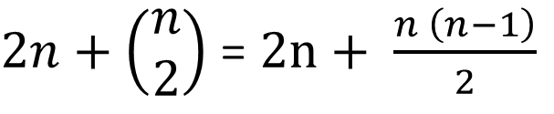
kernel methods
$2n+\left(\begin{matrix}n \\ 2\end{matrix}\right)$ = $2n+ \frac{n \left(n−1\right)}{2}$
features….

Slide 27
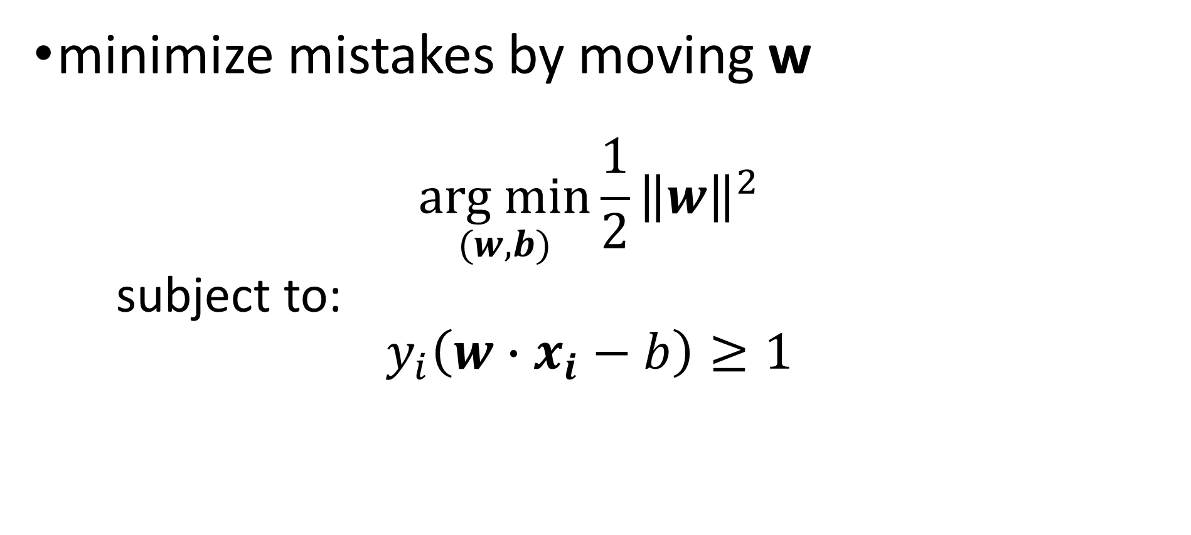
perceptron
minimize mistakes by moving w
$$\underset{(w, b)}{arg min}{\frac{1}{2}{\left\|w\right\|}^{2}}$$
subject to:
$$y_{i}\left(w∙x_{i}−b\right)≥1$$

Slide 28
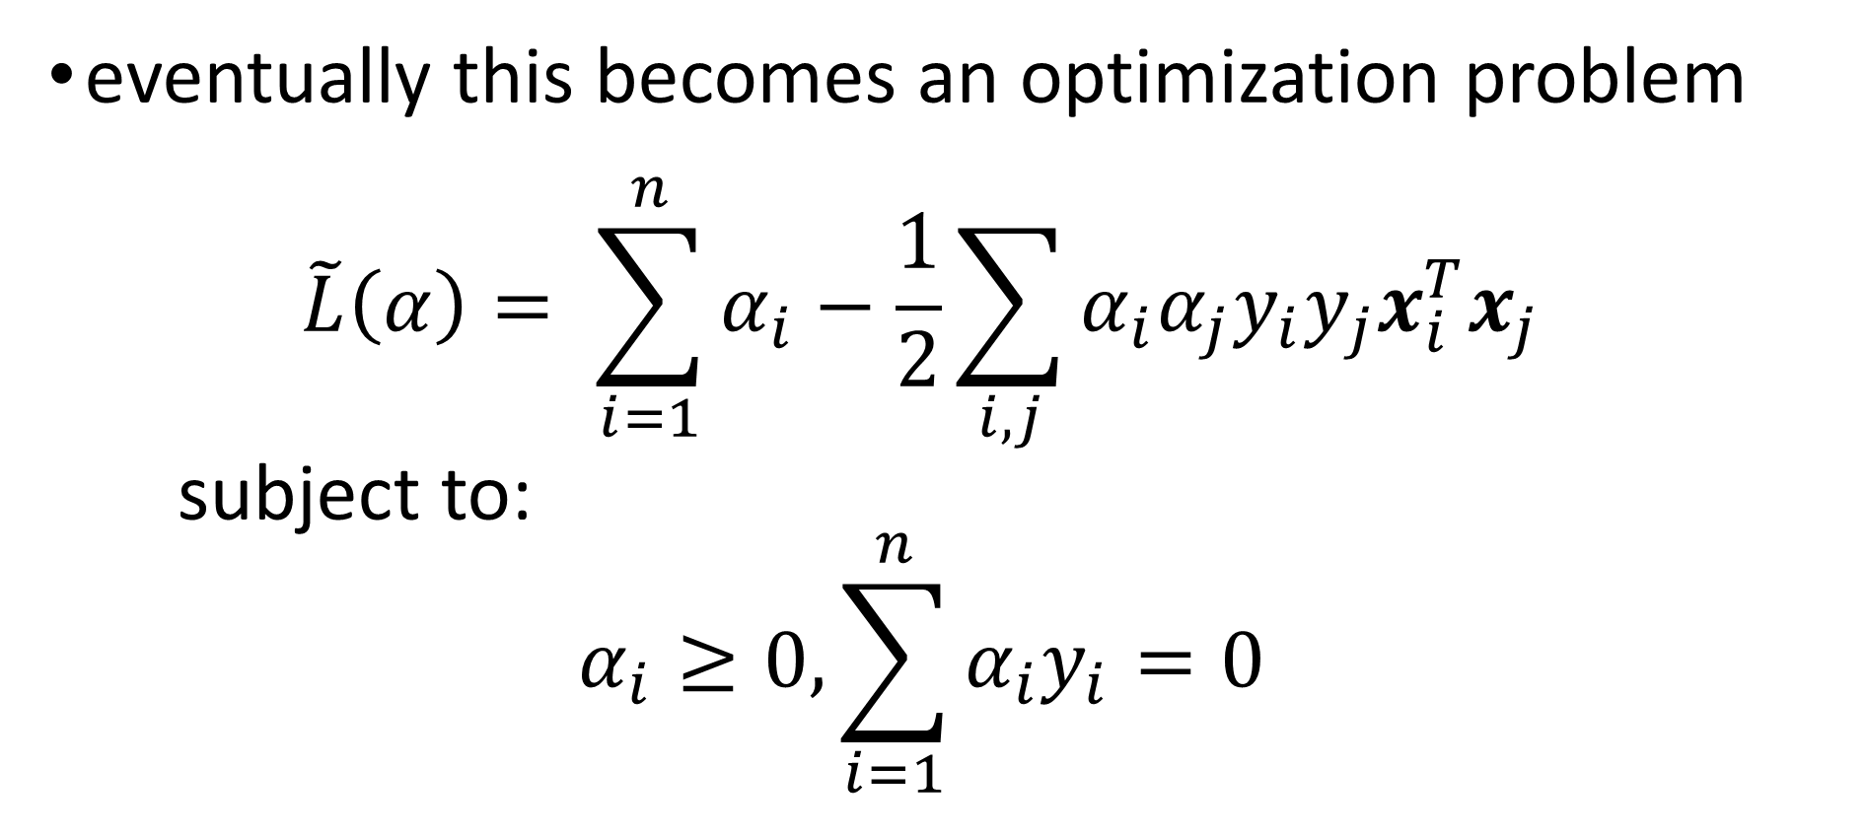
perceptron
eventually this becomes an optimization problem
$$\tilde{L}\left(α\right)= \sum_{i=1}^{n}{α_{i}}−\frac{1}{2}\sum_{i,j}{α_{i}α_{j}y_{i}y_{j}x_{i}^{T}x_{j}}$$
subject to:
$$α_{i}≥0, \sum_{i=1}^{n}{α_{i}y_{i}=0}$$

Slide 29
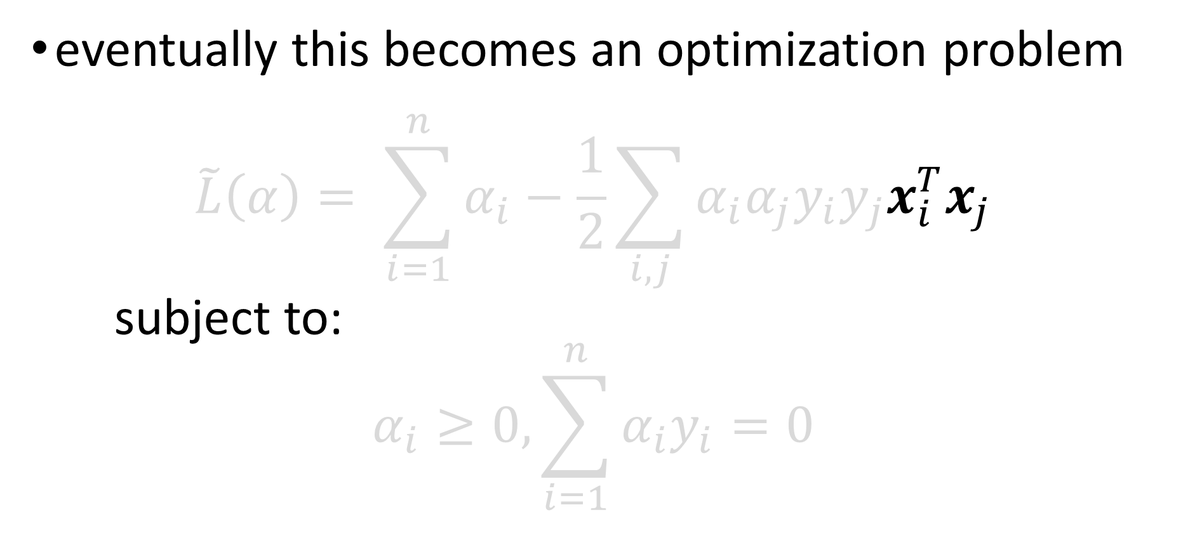
perceptron
eventually this becomes an optimization problem
$$\tilde{L}\left(α\right)= \sum_{i=1}^{n}{α_{i}}−\frac{1}{2}\sum_{i,j}{α_{i}α_{j}y_{i}y_{j}x_{i}^{T}x_{j}}$$
subject to:
$$α_{i}≥0, \sum_{i=1}^{n}{α_{i}y_{i}=0}$$

Slide 30
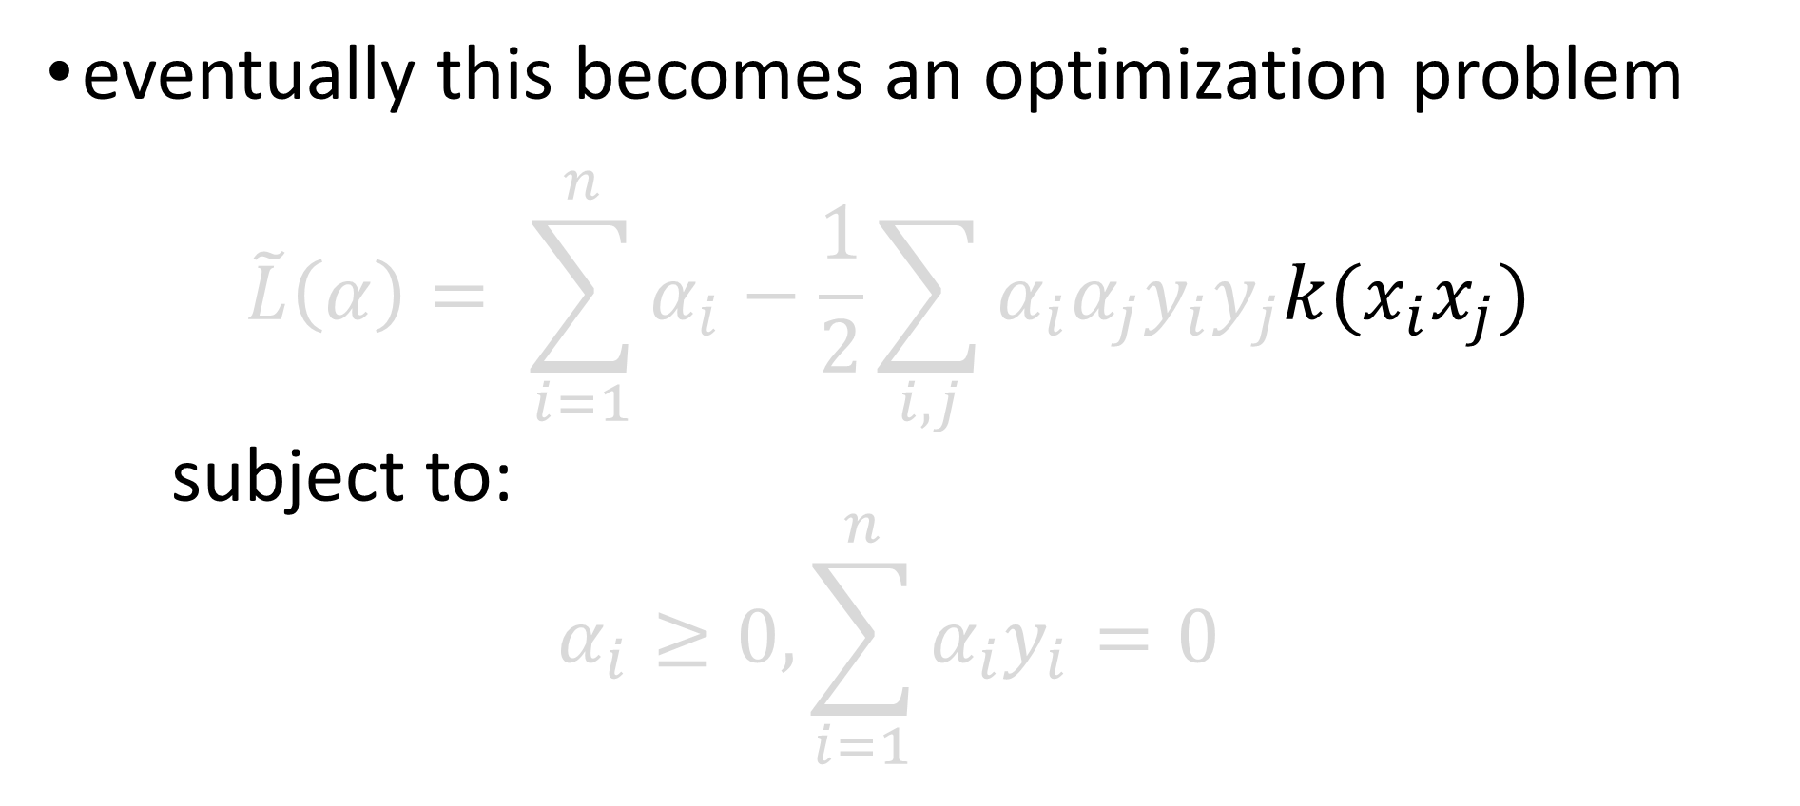
perceptron
eventually this becomes an optimization problem
$$\tilde{L}\left(α\right)= \sum_{i=1}^{n}{α_{i}}−\frac{1}{2}\sum_{i,j}{α_{i}α_{j}y_{i}y_{j}k(x_{i}x_{j})}$$
subject to:
$$α_{i}≥0, \sum_{i=1}^{n}{α_{i}y_{i}=0}$$
dot product

Slide 31
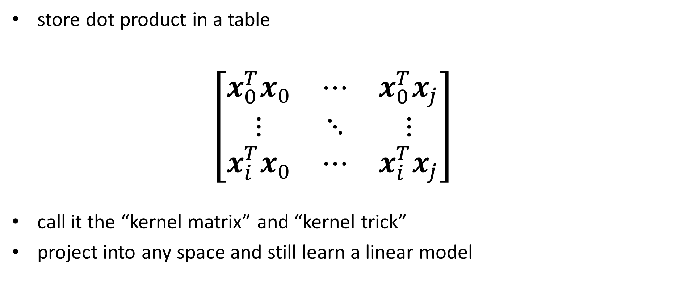
kernel (one weird trick….)
store dot product in a table
$$\left[\begin{matrix}x_{0}^{T}x_{0} & ⋯ & x_{0}^{T}x_{j} \\ ⋮ & ⋱ & ⋮ \\ x_{i}^{T}x_{0} & ⋯ & x_{i}^{T}x_{j}\end{matrix}\right]$$
call it the “kernel matrix” and “kernel trick”
project into any space and still learn a linear model

Slide 32
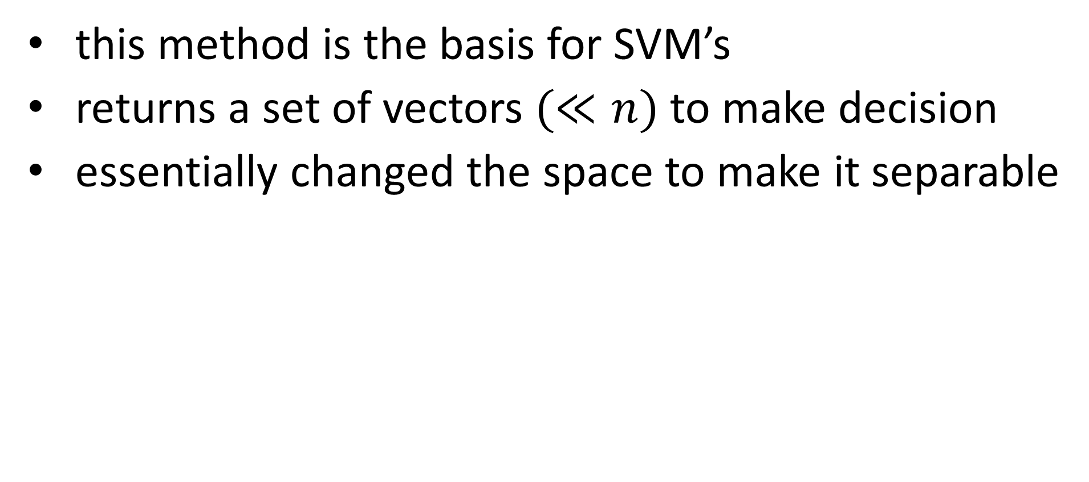
support vector machines
this method is the basis for SVM’s
returns a set of vectors $(≪n)$ to make decision
essentially changed the space to make it separable

Slide 33
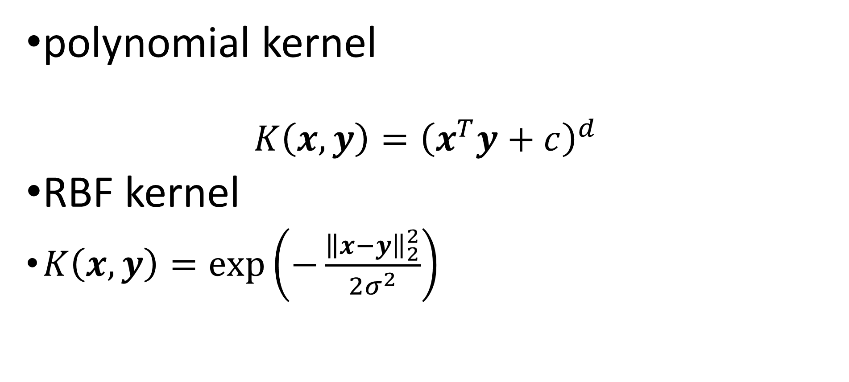
kernels
polynomial kernel $K\left(x,y\right)={\left(x^{T}y+c\right)}^{d}$
RBF kernel
$K\left(x,y\right)=exp\left(−\frac{{\left\|x−y\right\|}_{2}^{2}}{2σ^{2}}\right)⁡$
1
1

Slide 34


Slide 35
what if…

Slide 36
neural networks
models

Slide 37
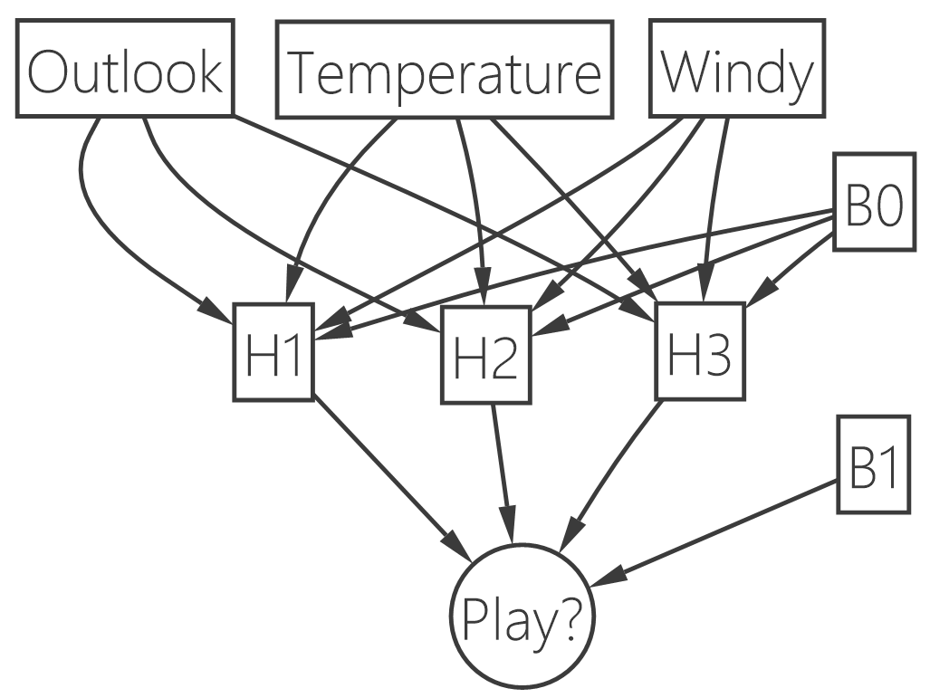
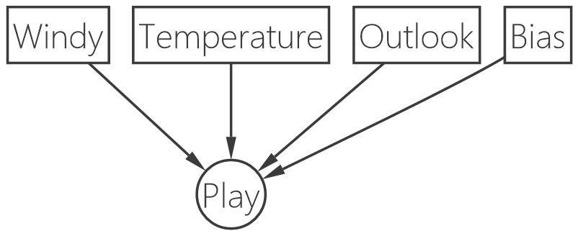
neural networks

Slide 38
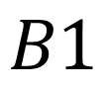
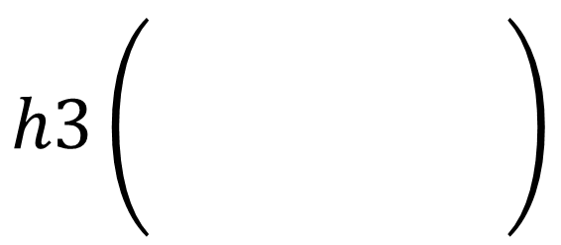
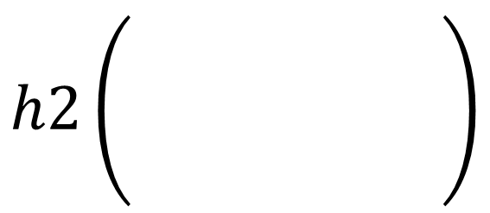

neural networks
$$h1\left(\begin{matrix} & & \\ & & \\ & & \end{matrix}\right)$$
$$h2\left(\begin{matrix} & & \\ & & \\ & & \end{matrix}\right)$$
$$h3\left(\begin{matrix} & & \\ & & \\ & & \end{matrix}\right)$$
Play?
$$B1$$

Slide 39
linear methods (ish)
perceptron (what if we can’t make a line?)
svm – change the space
neural networks – change the function

Slide 40
decision trees
models

Slide 41
model
Class | Outlook | Temp. | Windy
Play | Sunny | Low | Yes
No Play | Sunny | High | Yes
No Play | Sunny | High | No
Play | Overcast | Low | Yes
Play | Overcast | High | No
Play | Overcast | Low | No
No Play | Rainy | Low | Yes
Play | Rainy | Low | No
? | Sunny | Low | No

Slide 42
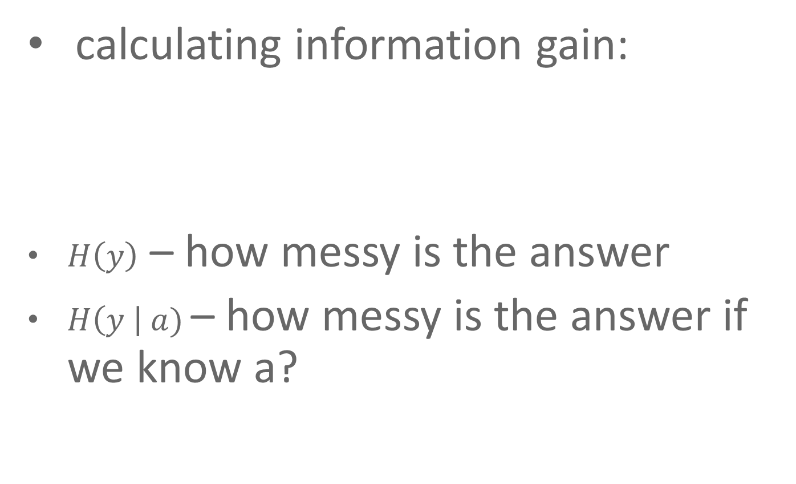
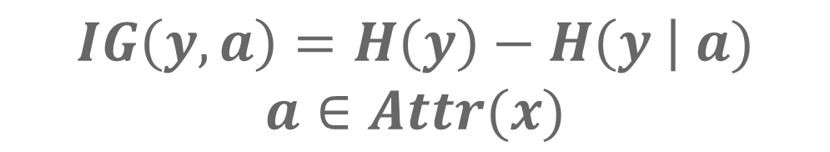
decision trees
calculating information gain:
$H\left(y\right)$ – how messy is the answer
$H\left(y \right| a)$– how messy is the answer if we know a?
$$IG\left(y, a\right)=H\left(y\right)−H\left(y \right| a)$$
$$a∈Attr(x)$$

Slide 43
decision trees
demo

Slide 44
popular models
support vector machines, neural networks, decision trees

Slide 45
do they work?
testing

Slide 46
how well is it doing?
Train
Test
Use 80%
Use 20%

Slide 47
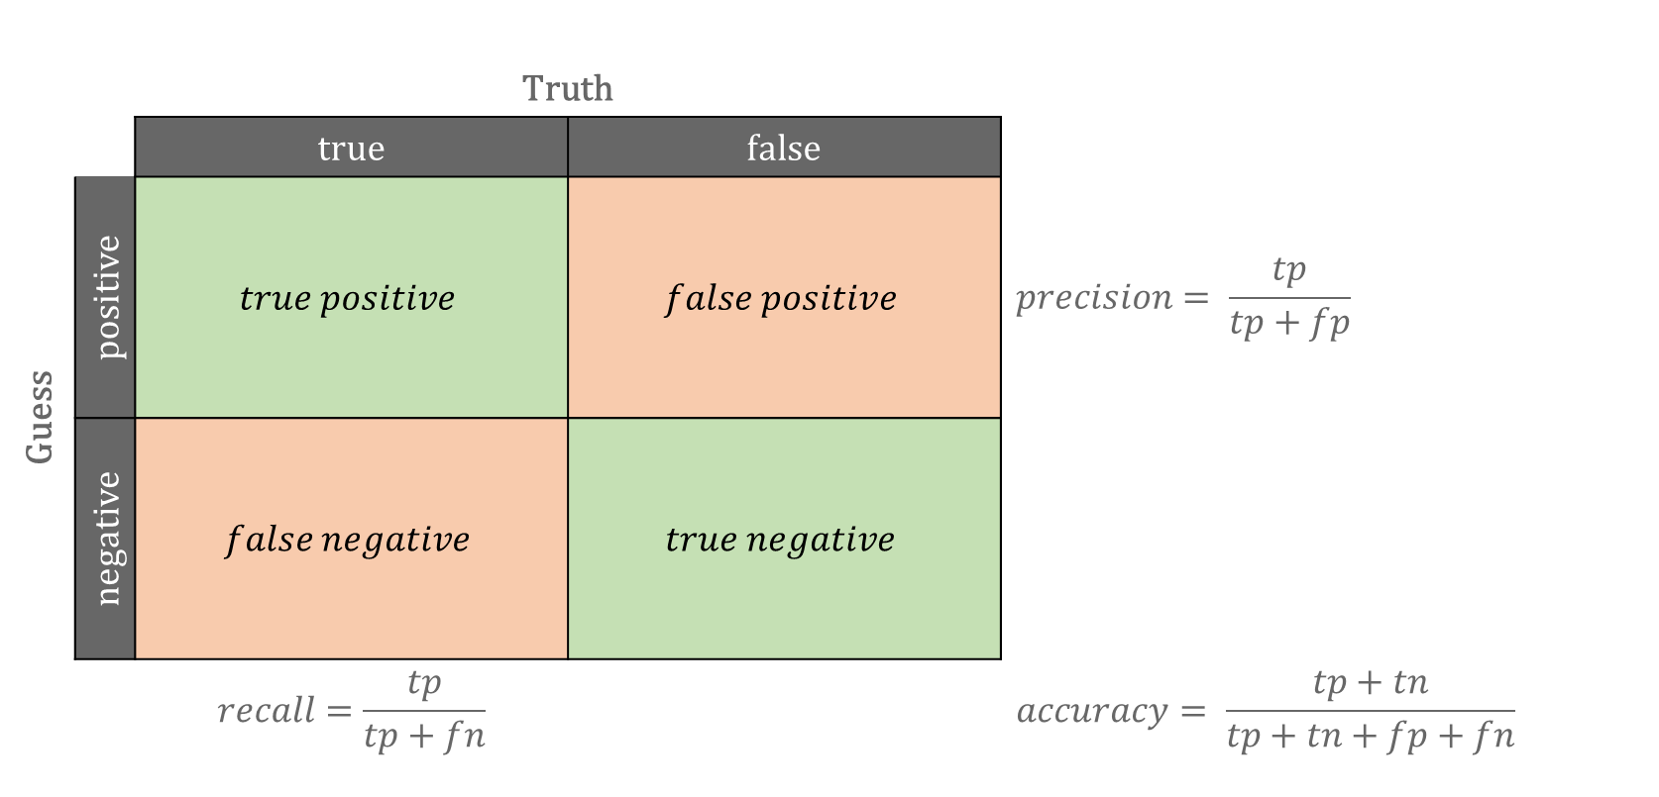
confusion matrix
 |  | Truth
 |  | true | false
Guess | positive | $$true positive$$ | $$false positive$$ | $$precision= \frac{tp}{tp+fp}$$
 | negative | $$false negative$$ | $$true negative$$
 |  | $$recall=\frac{tp}{tp+fn}$$ |  | $$accuracy= \frac{tp+tn}{tp+tn+fp+fn}$$

Slide 48
nuML
a .net library

Slide 49


Slide 50


Slide 51
working with data

Slide 52
nuML – working with data
Descriptor
data
1
Property
Features
Property
clean
transform
maths
…
Property
Label
2
Property

Slide 53
nuML – working with data
Class | Outlook | Temp. | Windy
Play | Sunny | Low | Yes
No Play | Sunny | High | Yes
No Play | Sunny | High | No
Play | Overcast | Low | Yes
Play | Overcast | High | No
Play | Overcast | Low | No
No Play | Rainy | Low | Yes
Play | Rainy | Low | No

Slide 54
declaring descriptors
public class Iris
{
[Feature]
public decimal SepalLength { get; set; }
[Feature]
public decimal SepalWidth { get; set; }
[Feature]
public decimal PetalLength { get; set; }
[Feature]
public decimal PetalWidth { get; set; }
[Label]
public int Class { get; set; }
}
var d = Descriptor.Create<Iris>();
strong
declaration

Slide 55
declaring descriptors
var d = Descriptor.For<Iris>()
.With(i => i.SepalLength)
.With(i => i.SepalWidth)
.With(i => i.PetalLength)
.With(i => i.PetalWidth)
.Learn(i => i.Class);
standard
declaration

Slide 56
declaring descriptors
var d = Descriptor.New()
.With("SepalLength").As(typeof(decimal))
.With("SepalWidth").As(typeof(double))
.With("PetalLength").As(typeof(decimal))
.With("PetalWidth").As(typeof(int))
.Learn("Class").As(typeof(int));
weak
declaration

Slide 57
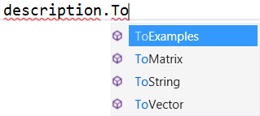

Slide 58
generating models

Slide 59
generating models
model.Predict(item);
predict
IModel
4
IGenerator
generate
model
descriptor
collection
3
Notes:
Load Iris example

Slide 60
built in generators / models
Perceptron (Generator, Model)
Kernelized Perceptron (Generator, Model)
KNN (Generator, Model)
Decision Trees (Generator, Model)
Naive Bayes (Generator, Model)
Neural Networks (Generator, Model)*
… and others (thanks to Chris Kalle)

Slide 61
review
data science
prediction
process
models
nuML

Slide 62
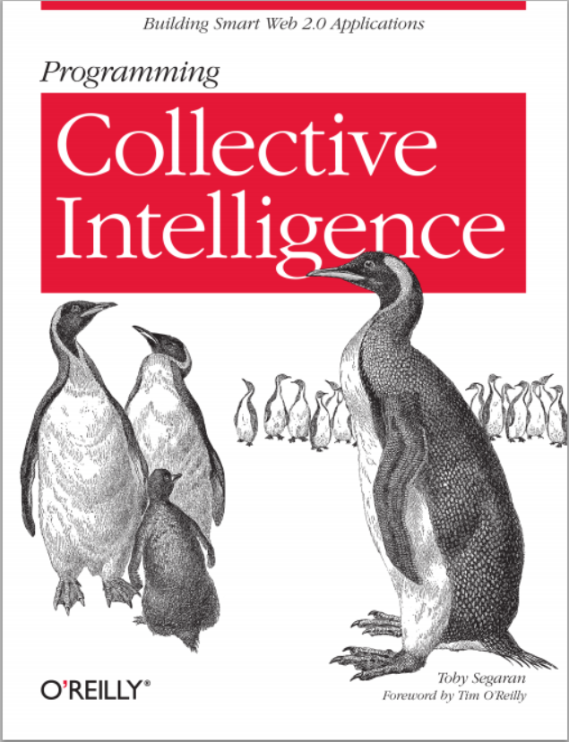
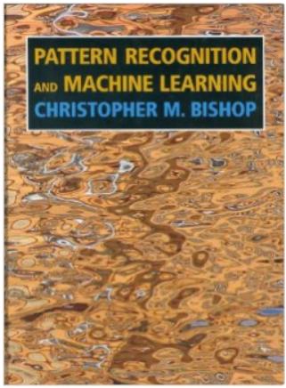
some reading

Slide 63
questions?
Seth Juarez
seth.juarez@microsoft.com
@sethjuarez

Slide 64
Lab
Download and run Iris Example
Try using different models
Try varying parameters
Titanic Dataset Challenge
Download titanic dataset starter
Try to create model to predict whether a person will die
Use: http://numl.net/getting-started/descriptors.html

